Slide 1
Business Intelligence G. Mudare
Notes:
Introduce yourself to the students and also find out there names
Have them give you in 30 seconds a summary of who they are and what there interest in IT is

Slide 2
Forms Of Data Pre-processing
Data Transformation

Slide 3
Data Transformation
Attribute Construction
Data Reduction
Data cube aggregation,
Attribute subset
Numerosity reduction,
Discretization and concept hierarchy generation,

Slide 4
Attribute Construction
new attributes are constructed from the given attributes and added in order to help improve the accuracy and understanding of structure in high-dimensional data.
Eg add the attribute area based on the attributes height and width.
By combining attributes, attribute construction can discover missing information about the relationships between data attributes that can be useful for knowledge discovery.

Slide 5
Data Reduction
To solve problems of Complex data analysis and mining on huge amounts of Data
Applied to obtain a reduced representation of the data set that is much smaller in volume, yet closely maintains the integrity of the original data.
Mining on the reduced data set should be more efficient yet produce the same (or almost the same) analytical results.

Slide 6
Strategies for data reduction
Data cube aggregation, where aggregation operations are applied to the data in the construction of a data cube.
Attribute subset selection, where irrelevant, weakly relevant, or redundant attributes or dimensions may be detected and removed.
Dimensionality reduction, where encoding mechanisms are used to reduce the data set size.
Numerosity reduction, where the data are replaced or estimated by alternative, smaller data representations such as parametric models (which need store only the model parameters instead of the actual data) or nonparametric methods such as clustering, sampling, and the use of histograms.
Discretization and concept hierarchy generation, where raw data values for attributes are replaced by ranges or higher conceptual levels.

Slide 7
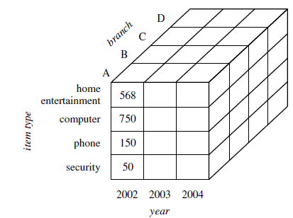
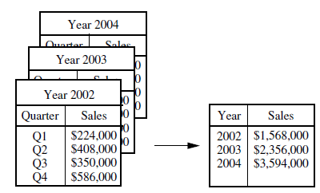
Data Cube Aggregation
Imagine that you have collected the data for your analysis. These data consist of the sales per quarter, for the years 2002 to 2004. You are, however, interested in the annual sales (total per year), rather than the total per quarter.
Thus the data can be aggregated so that the resulting data summarize the total sales per year instead of per quarter.
the data are aggregated to provide the annual sales.

Slide 8
Attribute Subset Selection
Attribute subset selection6 reduces the data set size by removing irrelevant or redundant attributes (or dimensions).
The goal of attribute subset selection is to find a minimum set of attributes such that the resulting probability distribution of the data classes is as close as possible to the original distribution obtained using all attributes.
Mining on a reduced set of attributes reduces the number of attributes appearing in the discovered patterns, helping to make the patterns easier to understand.

Slide 9
Dimensionality Reduction
In dimensionality reduction, data encoding or transformations are applied so as to obtain a reduced or “compressed” representation of the original data.
If the original data can be reconstructed from the compressed data without any loss of information, the data reduction is called lossless.
If, instead, we can reconstruct only an approximation of the original data, then the data reduction is called lossy.
Two popular and effective methods of lossy dimensionality reduction:
Wavelet Transforms
principal components analysis.

Slide 10
Wavelet Transform
The discrete wavelet transform(DWT) is a linear signal processing technique that, when applied to a data vector X, transforms it to a numerically different vector, X’, of wavelet coefficients.
The Wavelet filter applies a Haar wavelet transformation to the data.
Multi-Filters are used to replace missing values with means and modes, and to normalize the data.
The user can adjust the configuration of MultiFilter in order to modify the preprocessing that is done.

Slide 11
Principal Components Analysis
The original data are projected onto a much smaller space, resulting in dimensionality reduction.
Unlike attribute subset selection, which reduces the attribute set size by retaining a subset of the initial set of attributes, PCA “combines” the essence of attributes by creating an alternative, smaller set of variables.
The initial data can then be projected onto this smaller set.
PCA often reveals relationships that were not previously suspected and thereby allows interpretations that would not ordinarily result.

Slide 12
Principal Components Analysis basic procedure
Principal Components performs a principal components transformation on the dataset.
First, any multivalued nominal attributes are converted to binary, and missing values are replaced by means. The data is standardized (by default).
The input data are normalized, so that each attribute falls within the same range. This step helps ensure that attributes with large domains will not dominate attributes with smaller domains.
The number of components is normally determined based on the user-specified proportion of variance to be covered, but it is also possible to specify the number of components explicitly.

Slide 13
Numerosity Reduction
Can we reduce the data volume by choosing alternative, ‘smaller’ forms of data representation?”
Techniques of numerosity reduction:
parametric : a model is used to estimate the data, so that typically only the data parameters need to be stored, instead of the actual data. Eg Log-linear models,which estimate discrete multidimensional probability distributions,
Nonparametric: methods for storing reduced representations of the data include histograms, clustering, and sampling.

Slide 14
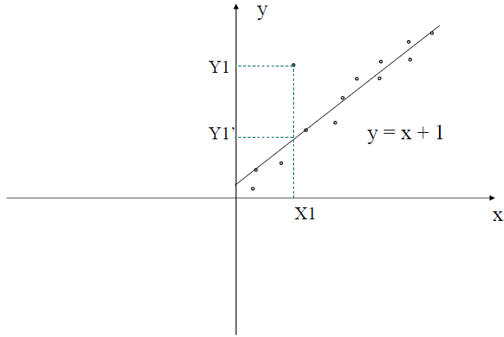
Use regression analysis on values of attributes to fill missing values.

Slide 15
Histograms
Histograms use binning to approximate data distributions and are a popular form of data reduction.
A histogram for an attribute, A, partitions the data distribution of A into disjoint subsets, or buckets.
If each bucket represents only a single attribute-value/frequency pair, the buckets are called singleton buckets.
Often, buckets instead represent continuous ranges for the given attribute.

Slide 16
Histograms with singleton buckets (Book example )
The following data are a list of prices of commonly sold items (rounded to the nearest dollar).
The numbers have been sorted:
1, 1, 5, 5, 5, 5, 5,8, 8, 10, 10, 10, 10, 12, 14, 14, 14, 15, 15, 15, 15, 15, 15, 18, 18, 18, 18, 18, 18, 18, 18, 20,20, 20, 20, 20, 20, 20, 21, 21, 21, 21, 25, 25, 25, 25, 25, 28, 28, 30, 30, 30.

Slide 17
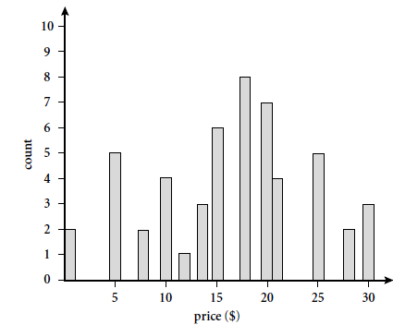
Histogram singleton buckets
each bucket represents one price-value/ frequency pair.

Slide 18
Buckets and attribute partitioning rules
Equal-width: In an equal-width histogram, the width of each bucket range is uniform
Equal-frequency (or equidepth): In an equal-frequency histogram, the buckets are created so that, roughly, the frequency of each bucket is constant (that is, each bucket contains roughly the same number of contiguous data samples).
V-Optimal: If we consider all of the possible histograms for a given number of buckets,the V-Optimal histogram is the one with the least variance. Histogram variance is a weighted sum of the original values that each bucket represents, where bucket weight is equal to the number of values in the bucket.
MaxDiff: In a MaxDiff histogram, we consider the difference between each pair of adjacent values. A bucket boundary is established between each pair for pairs having the β-1 largest differences, where β is the user-specified number of buckets.

Slide 19
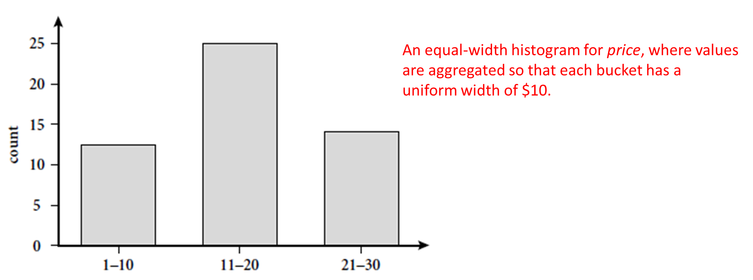
Equal-width histogram

Slide 20
Exercises

